Slide 1


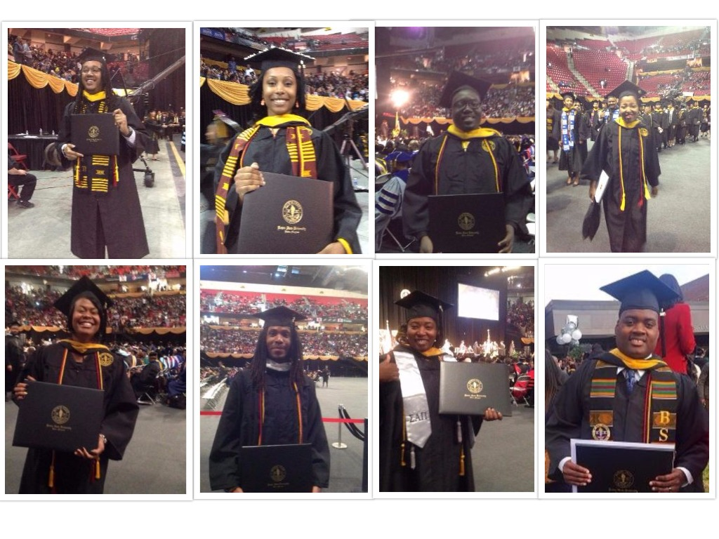
One Step Away Initiative
PURPOSE
This grant is designed to increase college completion rates by providing bachelor’s degree-granting Maryland institutions with seed monies to identify, contact, re-enroll, and graduate near-completer students. Near completers are those students who have earned a significant number of credits toward a bachelor’s degree, or may have enough credits for a bachelor’s degree but have stopped out or dropped out for more than twelve months without obtaining a degree.
OFFERINGS
Enhanced student support systems to include administrative, financial, and academic advising through degree completion.
New campus-based sustainable financial aid options using campus or other financial aid sources to support students with tuition assistance, vouchers for textbooks, housing, etc.
Provide students with laptops and school supplies as needed.
PROGRESS
BSU has received three OSA grants since AY2013-14.
Nineteen students graduated with the assistance of the OSA initiative thereby increasing the # of graduates by 1%.
Currently 12 students are enrolled.
Four students are slated to graduate in spring 2017.
Four students are slated to graduate in fall 2017.
Four are slated to complete their course of study in spring 2018.
BSU plans to submit a fourth RFP for the OSA program next year.
SURVEY RESULTS
Thirty two students participated in the OSA Initial Contact Survey
1. What was the primary reason you stopped attending BSU?
Answer Response Percent Response Count
Financial Reasons 53.13% 17
Family Issues 6.25% 2
Military Service 9.38% 3
Employment 9.38% 3
Other 21.88% 7
Seventeen students participated in the OSA Exit Survey
2. Overall satisfaction with OSA
Answer Response Percent Response Count
Very Satisfied 81.25% 13
Satisfied 18.75% 3
Dissatisfied 0.00% 0
Very Dissatisfied 0.00% 0
Neutral 5.88% 1
GENERAL INFORMATION
Project Director: Becky Verzinski, Ed.D.
Project Co Director: Lynn Harbinson, MBA
Funded by Maryland Higher Education Commission (MHEC)

