Slide 1
Purchase Card Training

Slide 2
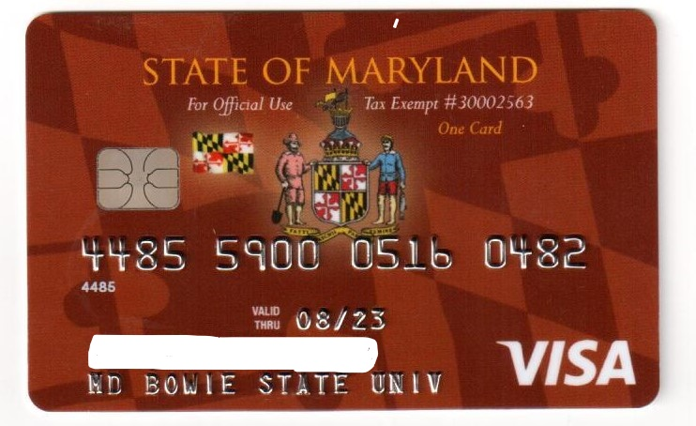
Header
This is a paragraph.

Slide 3
General Information
Call the 1-800 number on the back of the card to activate it.
The Single Purchase Credit Card Limit is $5000. The Monthly Limit is established based on actual usage. To request an increase in your credit limit email Joi Schumott
Your card limit is replenished on the 26th day of each month.
Purchase Card Logs are due to the BSU PCard Coordinator on the 12th day of each month. Statements should be received from the Bank no later than the 5th day of each month. If you have not received a statement by then please email jschumott@bowiestate.edu and an electronic copy can be sent to you.

Slide 4
REQUESTING A CARD
The agency's CPC Coordinator are responsible for issuing cards to the employee who will use them on a regular basis. If your position requires you to make purchases on a regular basis, the Corporate Purchasing Card may help you in your everyday tasks. To obtain a card, please follow these simple steps:
A. Submit a written request for a card to your Area Vice President;
B. If appropriate, the Area Vice President or designee will approve the request and forward the request to the agency PCPA or CPC Coordinator;
C. After receiving the request, the agency PCPA or CPC Coordinator will send the “Cardholder New Application Information Form” (Exhibit B), the “Cardholder Agreement Form” (Exhibit A), and a copy of the Bowie State University User’s Guide to the employee who will complete and sign the forms, obtain the signature of their appropriate supervisor and return them to the agency PCPA or Coordinator. Once application is approved it will be processed card will be sent.

Slide 5
CORPORATE PURCHASING CARD USE AND RESPONSIBILITY
The Bowie State University Corporate Purchasing Card (CPC) is an individual, not a department purchasing card. The Cardholder is solely responsible for the safety, security, and usage of the Corporate Purchasing Card. Corporate Purchasing Cards shall be used only for authorized purposes.
The CPC cannot be used for airline, trains, boats/cruise lines, buses or other similar travel charges such as parking, taxi service and gasoline purchases.
Travel expenses such as automobile rental, hotel/motel, and conference registration transactions are allowed by the state.
The Bowie State University Transportation Department is the only campus department authorized to use the CPC for van and bus rental services.

Slide 6

REMINDER: THIS CARD IS NOT TO BE USED FOR PERSONAL PURCHASES. PURCHASES MADE FOR PERSONAL USE ARE THE EQUIVALENT OF THEFT.
INDIVIDUALS WHO USE THIS CARD TO MAKE PERSONAL PURCHASES WILL BE SUSPENDED AND/OR TERMINATED FROM EMPLOYMENT, AND/OR FINED, AND/OR CRIMINALLY PROSECUTED.

Slide 7
VIOLATIONS
If an employee abuses the Corporate Purchasing Card privilege or the provisions of the Corporate Purchasing Card agreement, the card may be forfeited and cancelled and the employee is subject to disciplinary action up to and including dismissal. Also, the employee will be ineligible for restoration of Corporate Purchasing Card privileges.
Individuals who fail to adhere to these administrative procedures will be disciplined based on the process below. Offenses are accumulated over a twelve month period that runs consecutively with the fiscal year. With the beginning of each fiscal year cardholder’s previous year offenses are purged.
Individuals that do not submit their Purchasing Card Transaction Logs on time, fail to sign their log, fail to have their supervisor sign their log, fail to provide receipts or other required documentation certifying their purchases will have their PCard privileges suspended until all of those requirements are met.
Individuals that display a pattern for not adhering to the Administrative requirements of the CPC program, such as late submittal of monthly transaction logs, failure to submit copies of the monthly transaction logs, failure to sign or have their supervisor sign their logs, or failure to submit required receipts may lose their PCard privileges if they receive more than four notices of violation from the PCPA or CPC Coordinator within the same fiscal year period.
ta

Slide 8
5
Violations Purchase Card Terminated
VIOLATIONS

Slide 9
A. Contracted Services - Any services that may be IRS Form 1099 reportable are NOT authorized purchases (see Section 2 for definition of IRS Form 1099).
B. Gift Cards and Cash Advances/Money Orders - are strictly prohibited. There will be a forty-five (45) day suspension of CPC privileges. Cardholder who purchases gift cards or other cash like items with the card may be terminated.
C. Sharing Cards: Cards cannot be shared. Employees should be issued a card if they are making purchases on a regular basis.
D. Reward/Bonus Programs: Reward/bonus programs are manufacturer, internet, and store incentives designed to encourage cardholder’s to make purchases. Examples of reward/bonus programs are, but not limited to the following:

Slide 10




Allowable Purchases With Approval from Joi Schumott Purchase Card Coordinator.
Amazon
New Egg
Walmart
Dollar Tree

Slide 11
CARDHOLDER LIMITS
The Maximum Monthly limit for Corporate Purchasing Cards for all State of Maryland employees is $15000. The single purchase
limit of $5,000. The Purchase Card Coordinator may adjust the monthly purchase limits upward when appropriate justification is provided. However, the maximum single purchase limit under all circumstances is $5,000.
As with current purchasing regulations, "splitting" purchases to exceed this limit is prohibited. “Splitting” is defined as any action taken specifically designed to circumvent (exceed) the single purchase limit, i.e. requesting a vendor process two or more individual transactions for the same item or service which combined exceed the single purchase limit.
When using your CPC to make hotel reservations first calculate the total cost for your stay. As part of your planning, you will need to determine the number of rooms and days required for your trip. If that dollar amount exceeds the single purchase limit on your CPC, then you cannot use the card to pay for the hotel room(s).
Individuals using the Purchasing Card for University approved travel such as hotels, motels, and automobile rental must provide a copy of their approved “Travel Request Form” with their monthly transaction log.

Slide 12
Additional Restrictions: Bowie State University has placed additional restrictions on the following purchases unless a one-time exception is made by the Director of Procurement or the Purchase Card Coordinator.
1. (pens, paper, pencils, etc) must be procured through the University’s Stockless Stores providers.
2. Computer Hardware, Software, Peripherals, etc.
3. Apparel, Clothing, Attire
4. Furniture (Maryland Correctional Enterprises has the right of first refusal)
5. Printing (Maryland Correctional Enterprises has the right of first refusal). However, the card may be used for copying.
6. On-line purchases that require the CPC number to be entered on to a vendor’s automated software ordering system.
7. Any item that will be given to another individual or organization.

Slide 13
RECORD KEEPING, DOCUMENTATION, & RECONCILIATION
A. A receipt showing the price of the item(s) purchased is required for each transaction.
B. Every transaction must be recorded on a Cardholder Monthly Transaction Log refunds included. The log must contain the transaction date, merchant name, description of the item(s) purchased, and quantity. The log must also contain the account to be charged (if different from that assigned to Corporate Purchasing card), and the amount of the purchase. This information will be used to reconcile the monthly charges against the Corporate Purchasing Card statement.
C. A Monthly Cardholder Statement will be sent by the card vendor to each cardholder after the cutoff on the 25th day of the month . The cardholder is responsible for reconciling the Monthly Cardholder Statement to the Transaction Log, attaching all receipts, signing, and returning the package to their immediate supervisor/approver.
D. The Cardholder's immediate supervisor/manager or designee as assigned by the Department Head, who has the responsibility and experience to determine if Purchases are reasonable and necessary, must confirm that the purchases are business appropriate, and certify to the accuracy and completeness of the Transaction Log by signing and dating the log. The signature of the reviewer/ manager affirms that the applicable receipts/invoices and bank statement are attached to the Log, and the accuracy of the monthly detail, including whether or not the transactions are appropriate. The immediate manager should then forward all of the original documents and one copy of the monthly transaction log to the Purchase Card Department for processing.

Slide 15
FRAUD
Cardholder’s should disregard any e-mails that they receive that appears to be sent from US Bank. US Bank does not send emails directly to agency cardholders. Only agency Program Administrators may receive emails from the Bank when they have made changes to profiles, etc. or are required to perform an action for agency purchasing cards.
US BANK
If your Corporate Purchasing Card is lost or stolen, you must telephone the card vendor’s Customer Service immediately. This number is available 24 hours a day, 7 days a week, and 365 days a year. Lost cards reported by telephone are blocked immediately. If requested before 3:00 P.M. EST, a cardholder will receive an emergency replacement card usually within 24 hours. In addition, you must call the Procurement Office on the first available business day during normal business at
Purchasing Card Program Administrator (PCPA): Steven Jost
Room # 102, Maintenance Building
Phone: (301) 860-4212
E-mail: sjost@bowiestate.edu
CPC Coordinator: Joi Schumott
Room # 108, Maintenance Building
Phone: (301) 860-4184
E-mail: Jschumott@bowiestate.edu
The PCPA or CPC COORDINATOR will provide support and assistance to cardholders, campus Departments/Schools, etc; distribute/process new card applications, process changes in cardholder information (name, mailing address, increase or decrease in limits, etc.).

