Slide 1

New Hire Orientation

Slide 2
Health and Retirement Benefits
Notes:
Good Morning, my name is _____and today I will be going over some general information about your retirement and benefits package. The purpose of this section of the orientation is to explain how each program works so that you may choose the option that better meets your needs.

Slide 3

Retirement
Must make a decision today regarding your retirement plan!
2 Options:
Maryland State Retirement and Pension System (MSRP)
Defined Benefits Plan
Optional Retirement Plan (ORP)
Defined Contribution Plan
Notes:
The Maryland State Retirement System is the official retirement plan for PIN State employees. Supplemental retirement plans are not considered a retirement system under MD law.
Enrollment in a MDSR plan is a condition of employment for MD state employees. If an employee is not enrolled in a plan at the start of employment, it can affect the employee’s pay because they cannot be placed on payroll until the forms are submitted.
As an eligible employee of Bowie State University, you have the option of participating in one of two retirement programs.
The Maryland State Retirement and Pension system
The optional retirement plan
Both alternatives offer income when you retire. The main difference between the two is that the SRPS is a defined benefit plan and the ORP is a defined contribution plan.
Employees who are eligible to enroll in a retirement plan are regular exempt and Non-Exempt employees. Non-Exempt employees are only eligible to enroll in the Maryland State Retirement and Pension plan.
Your election to join the ORP or the SRPS is a one-time, irrevocable election and cannot be changed.
Contractual employees are not eligible to enroll in a retirement plan. However, they can enroll in a supplemental retirement plan. For more information about the supplemental retirement plan, please send an email to our Manager of Benefits and Wellness, Anjanette Evans at aevans@bowiestate.edu.

Slide 4
Maryland State Retirement and Pension System (MSRP)
Mandatory employee 7% contribution
Invested by MSRP Board of Trustees
Defined Benefit Plan:
Ordinary Disability Retirement
Must be permanently disabled and have 5 or more years of eligible service
Accidental Disability Retirement
Must be permanently and totally disabled as a direct result of a job-related injury
Death benefits
Cost of Living Increases periodically
Must be here 10 years to be fully vested, unless prior state service before 7/1/2011
Limited portability among certain governmental agencies within the State of Maryland
Notes:
Contribution
Your employer contributes a certain amount, which is determined annually by the state system’s actuary. You must contribute 7% of your earnable compensation.
Investment Management
The SPRPS assets are invested by the Investment Division of the SRPS and external professional investment managers chosen by the SRPS Board of Trustees. You do not bear any personal investment risk.
Defined Benefit Plan
MSRPS offers benefits such as ordinary disability and accidental disability, death benefits, and cost of living increases periodically
Vesting
You are fully vested after completing 10 years of eligibility service.
Limited Portability
Limited portability among certain governmental agencies within the State of Maryland.

Slide 5
How Benefits Are Determined and Paid with MSRP
Benefits Determined By a Formula
-Fixed percentage of your years of credible service
-Average Final Salary X the multiplier (.018) X years of service
How Benefits Are Paid
-Single-Life Annuity (Return of a single payment to your survivor(s) at your death)
-Dual-Life Annuity (A continuing monthly payment after your death to your surviving beneficiary)
Notes:
How benefits are determined:
Benefits are calculated using a specific formula that takes into consideration your age, a fixed percentage of your years of service, and your average final compensation.
How benefits are paid:
You may select one of several payment options available

Slide 6
Maryland State Retirement and Pension System (MSRP)
Normal Service Retirement
-Age 65 + 10 or more years of service
-Factor of 90: Years of service plus your age must equal 90
Early Retirement
-Age 60 + 15 or more years of service
- 6% annual reduction if less than 65
Notes:
Normal Service Retirement
You are eligible for normal service retirement when your eligibility service equals 90 or at age 65 with 10 years of eligibility service.
Early Retirement
If you retire early (age 60 with at least 5 years of eligibility service,) your monthly benefit will equal your normal service retirement benefit reduce by ½% for each month you retire before age 65.

Slide 7
Law Enforcement Officers’ Pension System (LEOP)
Mandatory employee 7% contribution
Invested by MSRP Board of Trustees
Eligible employees of the program can retire at the age of 50 years old
You must have 25 years of service

Slide 8
Optional Retirement Plan (ORP)
Defined Contribution Plan
Available only for exempt employees
State Contributes 7.25% of your base salary
Choice of Fidelity or TIAA
Immediately vested
Portable plan
Employee cannot make a contribution to this plan
If employees wish to make contributions, they would need to get a supplemental plan ( Fidelity, TIAA, Nationwide)
Notes:
-Defined Contribution plan
Contribution
Under this plan, The state contributes 7.25% of your base salary each year to your ORP account.
Only available to Exempt Employees
With this plan, you have the option of choosing between two investment vendors: Fidelity or TIAA.
You are immediately fully vested
Plan can be portable to other employers’ retirement programs.
You cannot make contributions to this plan.
If you would like to make contributions, you would need to get a supplemental retirement plan.
-State contributes 7.25% of your base salary
-You can choose Fidelity or TIAA
-Immediately vested
-Self directed plan which allows you to manage your own financial portfolio or the retirement program will manage for you
-Plan can be portable to other employers’ retirement programs
-Irrevocable decision if you go to the ORP plan.

Slide 9
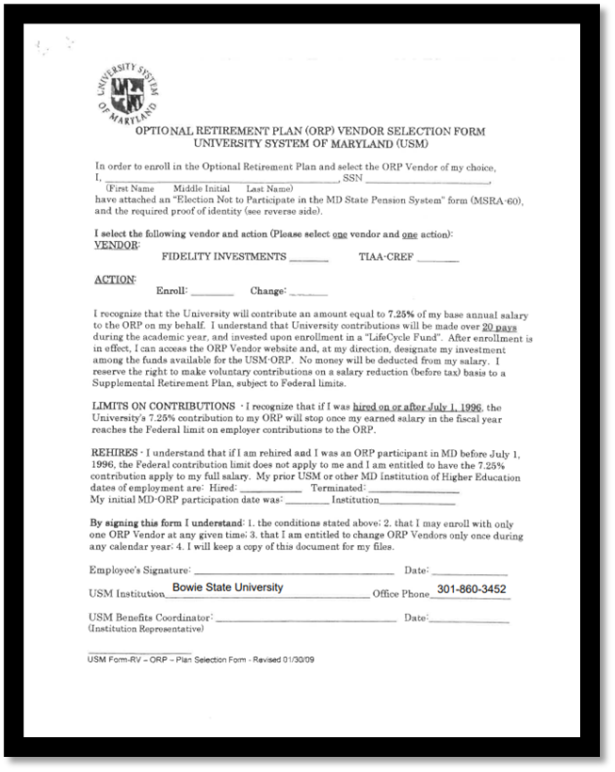
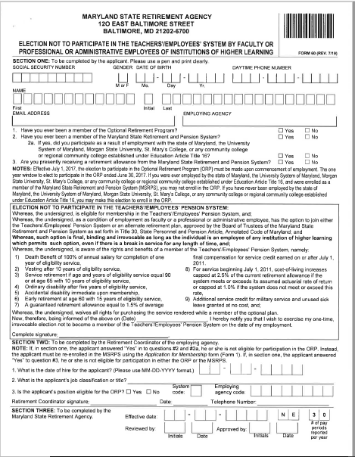
Forms that need to be completed TODAY ORP Retirement Plan

Slide 10
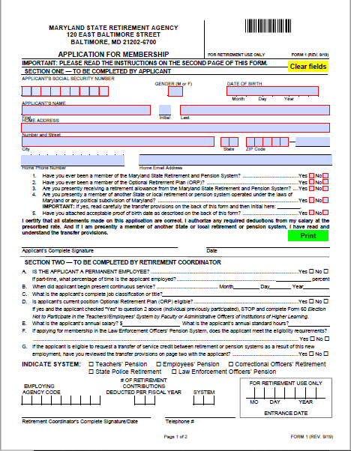
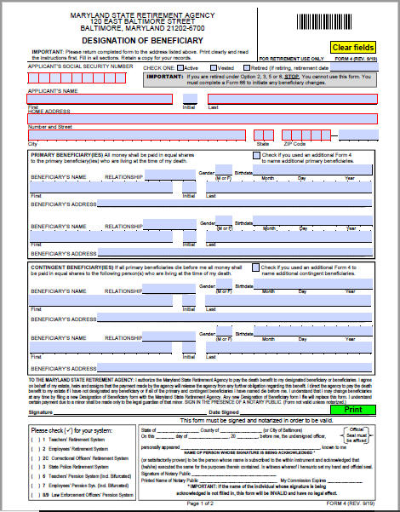
Forms that need to be completed TODAY Maryland State Pension Plan

Slide 11
Health Benefits
As an employee, the health benefits available to you represent a significant component of your compensation package. They also provide important protection for your and your family.
Guide to Your Health Benefits
Notes:
I’m delighted to go over your Benefits Package with your employment here at BSU, which represents a significant component of your COMPENSATION PACKAGE.
The State of Maryland provides a generous benefit package to eligible employees and retirees with a wide range of benefit options from healthcare to income protection.
I’ll be discussing your
Medical Benefits (Health, Dental, Vision, Prescription Drugs) Term Life Insurance
Accidental Death & Dismemberment Insurance
Flexible Spending Accounts
Tuition Remission

Slide 12
Health Benefit Options
When Coverage Begins
1st of the month following the date of hire
Qualifying Life Event (ex., Marriage, Divorce, or Birth of a child)
Health benefit enrollment is completed through Workday
Login information will be sent in 2 weeks (if delay, contact HR)
Must provide supporting documentation for dependents (birth certificate, state official marriage certificate) within 60 days of entry-on-duty through SPS Workday
Eligible Dependents include a Legal Spouse, Domestic Partner, and Children up to age 26.
See 2024 Benefits Guide for more information
Notes:
Coverage begins on the 1st of the month following the date of hire for all new hires and newly eligible employees.
All Health Benefit elections are completed through a platform called Workday. To receive access to Workday, you will receive an email from the State of Maryland with your W number, password, and a link to set up your Workday account. This link is set to expire within 24hours. If you miss this email, please call Anjanette Evans to receive a new link.
It take approximately 2 -3 weeks to receive your login information because there is a process that is completed by the HRIS team in conjunction with our Benefits Manager to set you up in the systems.
If you are interested in enrolling a dependent, you will be required to provide supporting documentation for them. This includes (birth certificate, or a state official marriage certificate (Must be signed by the registrar.)
-Benefit deductions will be taken out either the 1st of 16th of the month, depending on when your enrollment is processed by the state. If you go to the doctor during the waiting period for your benefits to be taken into effect, we can make a retro back to your date of service and you will pay a check for the previous missed pay period deductions.
-Please provide us with the official marriage license and birth certificates, you and your dependent will not be covered until the State receives those documents.
-After 60 days, you will have to wait for the open enrollment period to enroll.

Slide 13
Medical Plan Options
You have 5 Medical Plans to choose from (PPO, EPO or IHM)
Two Preferred Provider Organization (PPO) Plans:
CareFirst BlueCross BlueShield PPO
United Healthcare PPO
Two Exclusive Provider Organization (EPO) Plans:
CareFirst BlueCross BlueShield EPO
United Healthcare EPO
One Integrated Health Model (IHM) Plan:
Kaiser Permanente IHM
Each has different provider networks, however all have cover the same services such as: (preventative care, specialty care, lab services and x-rays, hospitalization and surgery, routine vision care, and mental health/substance abuse treatment.)
Notes:
The State offers several comprehensive medical plan options—all designed to reduce your out-of-pocket cost for most medically necessary services and promote wellness.
Choosing a Medical Plan
You have five medical plans from which to choose:
Two PPO options:
• CareFirst BlueCross BlueShield PPO
• United Healthcare PPO
Two EPO options:
• CareFirst BlueCross BlueShield EPO
• United Healthcare EPO
One IHM option:
• Kaiser Permanente IHM
Please note that prescription coverage must be elected separately. While each plan has a different provider network, all cover the same services.
-UHC and BCBS are both under the PPO and EPO plans.
-IHM plan is Kaiser

Slide 14
Medical Plan Details
Preferred Provider Organization (PPO) Plans:
Gives you the most flexibility
You can go to any health care professional you want inside or outside of your network without a referral
Exclusive Provider Organization (EPO) Plans:
More restrictive
Must select Primary care physician before seeing a specialist
You must use in-network providers
Services will not be covered for seeing a specialist outside your network
Integrated Health Model (IHM) Plan:
All healthcare services are contained at Kaiser Permanente locations
Smooth transition from clinic to hospital or from primary to specialty care
Some services require pre-certification
Notes:
-Preferred Provider Organization (PPO) Plans: It’s a flexible plan that allows you to go in and out of your network without referrals.
-Exclusive Provider Organization (EPO) Plans: Healthcare providers who participate in the plan and it costs significantly less.
-Integrated Health Model (IHM) Plan: Healthcare providers work together. There’s a smooth transition from primary care to specialty care.
PPO, HMO, and EPO are words used to define various health insurance plans that govern how medical services are reimbursed and compensated in medical billing and coding.
Preferred Provider Organization (PPO) Plan
With a PPO plan, you can see any doctor you want, whenever you want. However, the PPO plan has a national network of doctors, hospitals and other healthcare providers that you are encouraged to use.
These “in-network” providers have contracts with the PPO plan and have agreed to accept certain fees for their services. Because their fees are lower, the plan saves money and so do you. You pay more for care if you use out-of-network providers.
PPO plans are available through Carefirst BlueCross BlueShield and United Healthcare. Both cover the same services, treatments and products. However, the cost of coverage and the provider networks are different. (See the charts in the Health Benefits Guide) to compare these two plans.
Exclusive Provider Organization (EPO) Plan
With an EPO plan, the Plan pays benefits only when you see an in-network provider (except in an
emergency) within a national network. However, your out of pocket costs are lower. An EPO plan only
covers eligible services from providers and facilities that are contracted in the EPO plan network.
EPO plans are available through Carefirst BlueCross BlueShield and United Healthcare. Both cover the
same services, treatments and supplies, but the cost for coverage and the provider networks are different. (See the charts in the Health Benefits Guide) to compare these two plans.
Integrated Health Model (IHM) Plan
An IHM plan refers to care that allows doctors, hospitals and the plan to work together to coordinate a
patient’s care for a total health approach. It allows for a smooth transition from clinic to hospital or from
primary care to specialty care. This plan option is available through Kaiser Permanente. If you elect this
option, you need to reside in one of the following states; MD, DC, VA, DE, PA or WV and you must visit the
providers and facilities that are part of the Kaiser Permanente network in the Baltimore/DC/VA area only
for all of your care (except in an emergency). This option is only available to our members who are
not Medicare eligible.

Slide 15
Medical Plan PPO, EPO, IHM In-Network
No deductibles
Plans pay 90% for all in-patient and out-patient hospitalization
$1,000 out of pocket maximum per individual/$2000 per family
Notes:
All our plans offer the same coverages:
There is no deductible
Plans cover 90% for all in-patient and out-patient hospitalization cost
There is $1,000 out of pocket maximum per individual and $2,000 per family

Slide 16
Medical Plans PPO Out-of-Network
70% of allowed benefit after deductible
$250.00 deductible per individual/$500 per family
$3,000 out of pocket max per individual/$6,000 per family*
*Not applicable to the EPO plans

Slide 17
PPO and EPO Co-pay
Primary Care Provider office visit: $15 co-pay
Specialist Office visit: $30 co-pay
Urgent Care:$30 co-pay
Emergency room: Facility co-pay of $75.00+ Physician co-pay of $75.00= $150
Fill out the Healthcare Assessment on your provider’s website and the $15 copay will be waived

Slide 18
Behavioral Health and Vision Benefits
Eligible Behavioral Health services
Are covered as any other illness- $15 co-pay
Inpatient services still need to be pre-authorized for full plan benefits
Vision services
Use your medical card for Vision benefits
Annual eye exam covered at 100%
Notes:
Behavioral covers your mental and emotional well being.
Behavioral health services are covered as any other illness under the each of the medical plans. There is a $15 co-pay for services.
Inpatient services still need to be pre-authorized for full plan benefits
For more information behavioral health benefits, please refer to the Benefits Guide.

Slide 19
Prescription Drug Plan
CVS Caremark
Separate deduction-not included with medical coverage
If members choose a brand name drug when a generic is available, member must pay generic co-pay plus the cost difference of the brand name drug vs. the generic drug
Co-pay is based on the type of medication and the quantity purchased
Notes:
The State offers prescription drug coverage through a separate plan; it is not included in your medical
plan. To have prescription drug coverage you must enroll in it.
The prescription drug plan is administered by CVS Caremark. After you elect coverage, you will receive an
ID card to present when you have your prescriptions filled at the participating pharmacy of your choice.
You may use any pharmacy in the CVS Caremark network which includes not only CVS, but also
chain retail pharmacies such as Giant, Walgreens and Walmart in addition to the many independent
pharmacies;
Your prescription drug coverage has a “mandatory generics” feature. If you purchase a brand name
medication when a generic medication is available, even if the brand name medication is prescribed by
your doctor, you must pay the difference in price between the brand name and the generic, plus the
applicable copayment;
-Separate deduction from your medical coverage
-Generic drugs are recommended within the plan
-Your copay is based on your type medication and the amount you choose
-You can get home delivery on some medications

Slide 20
Dental Plan
2 Plan Choices:
United Concordia (DPPO)
Member may seek care from either participating or non-participating dentists
Delta Dental (DHMO)
Must select a Primary Dental Office (PDO)
May only use participating dentists
No out of network coverage

Slide 21
Dental Benefits
United Concordia (DPPO)
Annual Deductible
-Individual $50.00
-Family $150.00
Annual Maximum per
participant (Only applies to Class II
and Class III)
- $1,500.00
Class | Allowed Amount | Services
Class I | 100% after deductible | Preventive services, fluoride treatments
Class II | 70% in & out of network after deductible | Fillings and oral surgeries
Class III | 50% in & out of network after deductible | Implants, crowns and bridges
Class IV | 55% in & out of network, $2,000 lifetime max. | Dependent children only
Delta Dental (DHMO)
Refer to reduced fee schedule for
allowed amount at
www.dbm.maryland.gov/benefits
Notes:
-Class I: Diagnostic & Preventive e.g. Preventive services, fluoride treatments
-Class II: Basic Services (e.g. fillings, oral surgeries)
-Class III: : Major Restorative procedures (e.g. implants, crowns and bridges)
-Class IV: Orthodontics (dependent children only). Delta dental covers Adult braces

Slide 22
Flexible Spending Accounts (FSA)
Pre-tax way to be reimbursed for eligible dependent care or health care expenses
Great if you know you have a big medical expense or procedure coming up in the future
Reduces taxable income
Eligible expenses for services incurred with plan year
Must re-enroll each year
Limited to $3,050 for Healthcare
Limited to $5,000 for Dependent Care
Funds are forfeited if you are terminated/resign
Contractual employees not eligible to enroll
Notes:
The two types of FSA accounts are described below:
Healthcare FSA
Use this account to pay for health, dental and vision expenses for you and your eligible dependents. When you enroll in a Healthcare FSA, the total amount you elect is available for use beginning on the first day of your plan year, January 1, 2024. This unique plan rule only applies to the Healthcare FSA.
Employees who enroll in the Healthcare FSA receive a Debit Card that can be used to pay for eligible expenses at the point of service. Benefits Cards are valid for three years, so if you are re-enrolling in the account, you may use your existing card. If your card is going to expire, you will automatically receive a new one in the mail.
Healthcare FSA maximum annual election amount: $3,050
Dependent Daycare FSA
Use this account to pay for your dependent child(ren)'s or dependent parent's daycare expenses. Your child must be under age 13 in order to qualify for reimbursement.
Dependent Daycare FSA maximum annual election amount: $5,000
REMINDER: the Dependent Daycare FSA is for daycare expenses; it does not reimburse health expenses for your dependents.

Slide 23
Contractual Employees

Slide 24
Keep in Mind
Temporary employees receive a modified benefits package
Differences can be noted in the following:
Payment method
Coverage costs
Services available

Slide 25
Contractual Employee Benefits
Premiums are due the 1st of each month
A contract renewal is not a qualifying event and does not permit changes to coverage elections
Effective date of coverage cannot be changed once enrollment is processed
Responsible for paying 25% of health benefits
Notes:
*All Faculty members here are PIN, if there are any LTC, please let me know, if not, I will move forward.
-Eligible to enroll into the same health plans as FT employees except for Flexible Spending Accounts
-There will be a coupon mailed every month and it’s due the 1st of the month
-Cancellation will happen if you do not pay within the 30 day grace period
-New contracts are not a qualifying event and you cannot make any coverage elections
-Your effective date cannot be changed once the State enrolls you

Slide 26
Contractual Employee Benefits
Must pay full cost of benefits by monthly coupon or online via the Department of Budget and Management website
https://www.velocitypayment.com/vbills/bankofamerica/dbmebd/login.go
It can take up to 6 weeks for the coupon book to be processed and received by employees
If this is the case, please plan accordingly, as employees may have to pay for multiple months at one time
Employees are given a 30-day grace period for nonpayment before benefits are terminated
Notes:
*All Faculty members here are PIN, if there are any LTC, please let me know, if not, I will move forward.
-Eligible to enroll into the same health plans as FT employees except for Flexible Spending Accounts
-There will be a coupon mailed every month and it’s due the 1st of the month
-Cancellation will happen if you do not pay within the 30 day grace period
-New contracts are not a qualifying event and you cannot make any coverage elections
-Your effective date cannot be changed once the State enrolls you

Slide 27
Term Life and AD & D Insurance
MetLife has partnered with the State of Maryland to provide
Term Life insurance
Accidental death and dismemberment (AD&D) insurance to you and your dependents.
Notes:
-Purchase $10k increments up to $300k
-You will have to go through a medical history assessment for any amount over $50k

Slide 28
Met Life Term Life Insurance
Employees
May purchase coverage in $10, 000 increments up to $300,000
No medical history needed on amounts up to $50,000
Amounts over $50,000 require medical history
Dependents - Spouse/Eligible children
Employees may purchase coverage in $5,000 increments up to 50% of your elected amount (up to $150,000)
Amounts over $25,000 require medical history
Notes:
-Purchase $10k increments up to $300k
-You will have to go through a medical history assessment for any amount over $50k

Slide 29
Met Life Term Life Insurance
Beneficiary Financial Counseling
Legal, Financial, and Grief Services
Legacy Planning Services
Accelerated death benefit
Pays up to 100% of life insurance if terminally ill with less than twelve months to live
Coverage can be continued after employment ends
Portability-coverage ends at age 70
Conversion-coverage converts to an individual life insurance policy (Premiums may be higher than those paid by active employees)
*(1-866-883-3514)
Notes:
-Travel Assistance Services: Services are available 24/7/365 for emergency assistance, transport services, and pre-trip resources, when traveling 100 or more miles away from home.
-Beneficiary Financial Counseling: Financial counseling program for beneficiaries.
-Legal, Financial, and Grief Services: Consultation on any legal matter as well as simple wills and estate planning documents
-Legacy Planning Services: Resources to help with working through end-of-life issues

Slide 30
AD& D Insurance
AD&D insurance provides beneficiaries with additional financial protection if an insured’s death is due to a covered accident, whether it occurs at work or elsewhere
- car accidents
- murders
Employees may purchase coverage in amounts of
$100,000
$200,000 or
$300,000
May choose either individual or family coverage
Family coverage pays benefits on a percentage of the whole amount based on the number of dependents
Notes:
-Gives beneficiaries additional financial protection if an insured’s death or dismemberment is due to a covered accident, whether it occurs at work or elsewhere.
-Coverage amounts: $100k, $200k, $300k
-Individual and family coverage. Family coverage pays on a percentage of the whole amount based on the # of dependents.

Slide 31
Metlife Optional Term Life Insurance (University)
Employee
Employee may purchase coverage in $10, 000 increments up to $750,000 No medical history needed on amounts up to $100,000
Dependents - Spouse/ Eligible children
Spouse: Employees may purchase coverage in $10,000 increments not to exceed $150,000
Children: Employees may purchase coverage based on the child’s age in the amounts of
Birth to 6 months: $1000
6 months to age 26 years: 10,000
Notes:
-You can purchase coverage in $10k increments up to $750k
-There will be a medical assessment over $50k

Slide 32
Metlife Optional Term Life Insurance (University)
Long Term Disability Plan
Provides a monthly benefit whether your disability prevents you from working at all or limits your ability to work
60% of your monthly earnings to a maximum of $10,000
Notes:
-Provides a monthly benefit whether your disability prevents you from working at all or limits your ability to work.
-60% of your monthly earnings to a maximum of $8,000.
Elimination Period
-3-month elimination period.
*The elimination period begins on the day you become disabled and is the length of time you must wait while being disabled before you are eligible to receive a benefit.
-Gives you a check for the rest of your life.

Slide 33
Tuition Remission
All Employees
Up to 8 credits per semester
Classes are offered at participating University System of Maryland Schools
Regular Employees and Long-term Contractual Faculty
Dependents and spouses are covered after 2 years of employment
For their first earned undergraduate degree
Contingent II Employees only at the home institution (BSU)
Dependents and spouses are not covered
*$5,250 IRS limit for graduate courses/per year
Notes:
Tuition Remission – your employer helps to finance your education.
Tuition Remission applies to tuition only
BSU tuition remission application deadline for the Winter 2024 semester is 01/31/23

Slide 34
Workday Onboarding Task
Any delay in completing the Onboarding task in Workday may delay in your first paycheck from being processed.
New Hire Policies Acknowledgements
Retirement Paperwork
Update Photo (Optional)
Update Education (Upload transcripts)
Payroll Documents
Update Emergency Contacts
Voluntary Disability
Veterans Status
Form I-9
MD New Hire Registry
Payroll Information
Agency Code: 360223
Payroll System:
RG for regular employees
CT for contractual employees

Slide 35
Resources to Get You Started
Notes:
Good Morning,
My name is Mrs. Ogan, and I will go over a few resources, people contacts and general information that would be helpful to get you started strong as a new employee of Bowie State University.

Slide 36

Bowie Points of Pride Brochure
Notes:
Here is a copy of our Bowie Points of Pride Brochure
Highlighting our
Modern teaching facilities
Innovative entrepreneurial partnerships & programs
Distinctive ways we've been recognized
How we are leading in STEM education and more

Slide 37

Bowie Core Values
Excellence BSU expects students, faculty, staff, and administrators to demonstrate outstanding performance levels by fostering a stimulating learning and work environment.
Inclusivity BSU is intentional about creating a community that encourages involvement, respect, and connection among students, faculty, staff, and administrators regardless of differences of race, gender, ethnicity, national origin, culture, sexual orientation, religion, age, and disability.
Integrity BSU students, faculty, staff and administrators demonstrate high ethical standards in their interactions with one another and the larger community.
Accountability BSU expects each member of the University community to be responsible and accountable for the outcomes of their efforts and actions.
Innovation BSU aspires to infuse innovative practices into academic and administrative functions by encouraging students, faculty, staff, and administrators to utilize best practices and pursue new opportunities.
Notes:
Here is a copy of our Bowie Points of Pride Brochure
Highlighting our
Modern teaching facilities
Innovative entrepreneurial partnerships & programs
Distinctive ways we've been recognized
How we are leading in STEM education and more

Slide 38
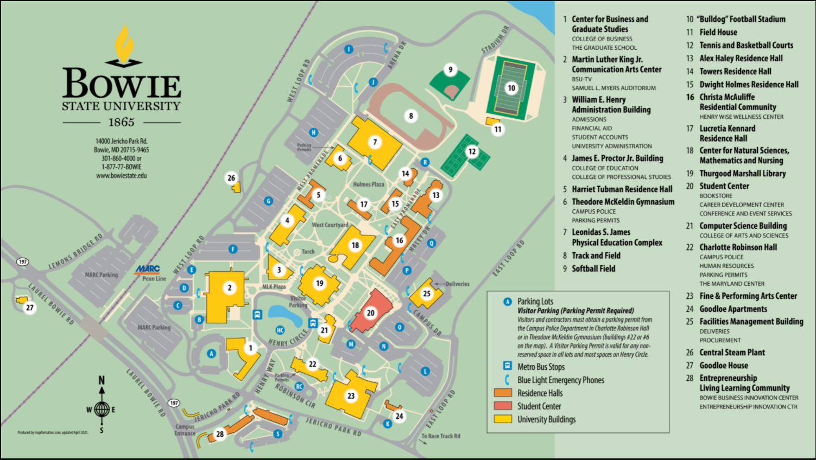
Campus Map
Notes:
Home›
Admissions & Aid›
Visit Us›
Campus Tour
Please visit the website to enjoy our interactive virtual tour of the beautiful Bowie State University campus and scroll through the slideshow below.
https://bowiestate.edu/admissions-and-aid/visit-us/campus-tour.php

Slide 39




B.E.E.S. (Bowie Electronic Emergency System)
The Police and Department of Public Safety encourages all employees to register with BEES to enhance your awareness and add an extra layer of safety
BEES is an electronic alert system that allows the university to send instant alerts via text and email advising of weather alerts, emergency or exigent occurrences which affect the campus community
Sign up to receive instant alerts to stay safe during inclement weather and other campus emergencies.
Contact: Lavel Jones,
Program Management Specialist,
(301) 860-4050
Notes:
Alerts about: Public Safety, inclement weather updates affecting alternative school hours
Some cell phone charges for text messaging may apply depending on your carrier.
Bees will only send emergency messages.
Problems while registering, please call Lavel Jones (301) 860-4050

Slide 40

New Hire Checklist
Employee/Network ID (provided today)
Your EMPLID provides access to your office computer and many web-based applications, and university services including:
Workday (Bowie Online Services)
E-mail, Calendar, and contact management (Outlook), OneDrive, SharePoint
Timesheets
Blackboard (online learning system)
Network file storage drives
Bowie card (Bulldog Card Office – Student Center)
Email/Intranet use (campus log-in, password)
HR sends info to DoIT
Access is granted through your department
Campus news (Automatically enrolled)
Broadcast emails
BSYOU e-Newsletter

Slide 41
Quick Reference Guide
Parking: The Office of Public Safety *operates 24 hours a day
Campus Safety: LaVel Jones 2-4050
Payroll: Web time Sandra Lockett 2-3483
Equity Compliance:
Sexual Harassment/Title IX: Adonna Green 2-3442
Labor & Employee Relations: Robert Enderle 2-3459
Department of Information Technology (DoIT): helpdesk@bowiestate.edu 2-4357
Help Desk
Telecommunication:
Telephone: Alona Turner 2-4106
Operational: Conference Services, Procurement, Facilities Management, Student Center (respectively) Booking a Conference Room: Annette Wedderburn 2-3839 Using a BSU Vehicle Robert Chiles 2-4215 Keys Facima Cardosogendreau 2-4190 Bulldog Card Jatina Cooke 2-3793
Bookstore Joshua Gunn 2-4350

Slide 42

Bulldog Card
The Bowie State University Bulldog Card is the official campus identification card for Faculty and Staff.
It can be used to…
Print/check-out library books
Load money for use on campus
Contact: Auxiliary Services Jatina Cooke, Student Center Manager jcooke@bowiestate.edu
Student Center, STE 1025 (#20 on the map)
(301) 860-3792
bulldogcard@bowiestate.edu
Notes:
The Bulldog Card is Bowie State University’s official ID for faculty, staff, and students.
Your Bulldog ID is a lot more than just a piece of personalized plastic. Here's where and how you can use your card.
As an identification card
As a meal card
Campus retail outlets
Paying fees (graduation, parking, etc.)
Buying books and apparel at the Bookstore
Print/Check out library books
Allocating Financial Aid
Vending Services (beverage and snack machines)
New Employees
All eligible employees are required to have a Bulldog Card while on campus. In order to receive a Bulldog Card, new employees must
Email a headshot to bulldogcard@bowiestate.edu (you’ll receive notification when ready for pickup)
Produce a copy of their New Employee Identification Card Memorandum completed by the HR Department (new employees or 1st issue)
Produce photo identification (government-issued ID, driver’s license, passport, etc.)
Please bring all documents to the Bulldog Card Office/Office of Auxiliary Services, on the first floor of the Student Center, Room 1025.

Slide 43
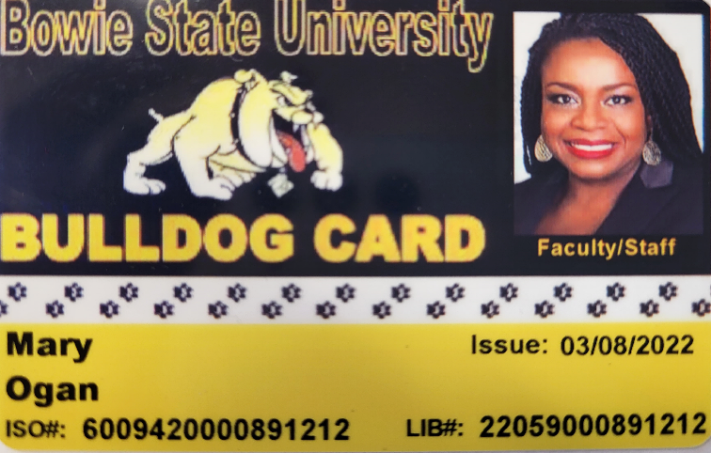
Bulldog Card
All faculty, staff and students are required to display their BSU ID while on campus.
The process to receive a BSU ID card:
Email your headshot photo bulldogcard@bowiestate.edu
Submit a color photo (taken within the last 6 months)
Use a clear image of your face. Do not use any filters
Have someone else take your photo (No selfies)
Remove eyeglasses for your photo
Use a plain white or off-white background.
You will receive an email once your BSU ID card is ready for pick-up from the Bulldog Card Box Office.
The office is located on the 1st floor of the Student Center
Open from 8:30 am -4:30 pm, Monday - Friday.
Contact: Auxiliary Services Jatina Cooke, Student Center Manager jcooke@bowiestate.edu
Student Center, STE 1025 (#20 on the map)
(301) 860-3792
bulldogcard@bowiestate.edu

Slide 44
Required Training
 | Topic | Audience | Contact | Timeline
 | Financial Disclosure Report (completed and submitted) | Directors and above |  | By April of each year
 | Maryland Public Ethics Law | Public Steward (VP, AVP, Directors…) | BSU-HR/State Ethics Commission Mary Ogan, mogan@bowiestate.edu | 6 months of hire
 | How to Conduct a Successful Performance Management Process, (PMP) Review | Managers and Supervisors | Office of Human Resources Mary Ogan, mogan@bowiestate.edu | Start of PMP cycle
 | Information Security Awareness | All employees | Division of Information Technology, (DoIT) helpdesk@bowiestate.edu | 6 months of hire and as requested by DoIT
 | New Employee Orientation | All employees | Office of Human Resources Anjanette Evans. aevans@bowiestate.edu Mary Ogan, mogan@bowiestate.edu | 1st day of hire
 | Requisitions and Purchase Order Training | Administrative Assistants, Clerical Staff, Staff Assistant and others as appropriate | Office of Procurement Joi Schumott, jschumott@bowiestate.edu | 6 months of hire
 | Sexual Harassment in the Workplace | All employees | Office of Equity Compliance Adonna Green agreen@bowiestate.edu | 6 months of hire
 | Supervisory Development Seminar | Managers and Supervisors | Office of Human Resources Mary Ogan, mogan@bowiestate.edu | 6 months of hire
Notes:
you will learn what information security is as well as what your responsibility is to help ensure that the principles are applied within your organization.

Slide 45
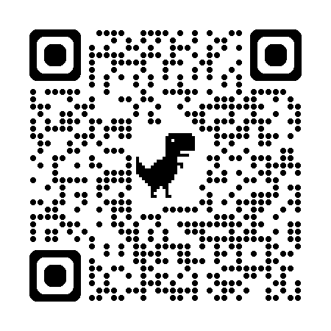
Required Training
Information Security Awareness
All employees
Division of Information Technology, (DoIT) helpdesk@bowiestate.edu https://helpdesk.bowiestate.edu Call 301-860-HELP/(301-860-4357)
6 months of hire and as requested by DoIT
In-person (30-minutes by appointment)
Requisitions and Purchase Order Training
Administrative Assistants, Clerical Staff, Staff Assistant and others as appropriate
Joi Schumott Corporate Purchasing Card Coordinator
Office of Procurement
301-860-4184 Jschumott@bowiestate.Edu
6 months of hire

Slide 46
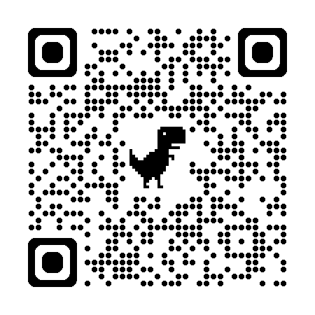
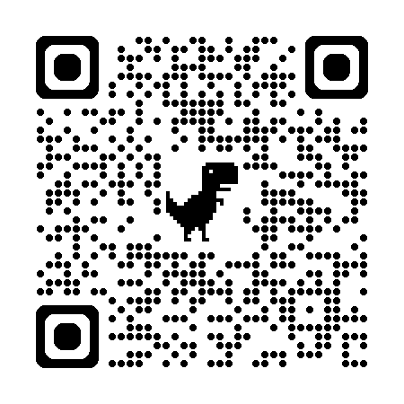
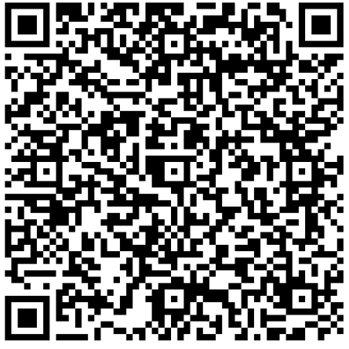
Required Training
Maryland Ethics Commission
Directors and above
Katherine Thompson
Assistant General Counsel
State Ethics Commission
45 Calvert Street, 3rd Floor
Annapolis, MD 21401 katherine.thompson@maryland.gov
410.260.7770
Due April of each year,
New hires: 1st time 30 days (email from the State Ethics Committee)
Don’t take the Lobbyist training option
Financial Disclosure Statement
Directors and above
Submit online through financial disclosure system
Training link -
Due April of each year,
New hires: 1st time 30 days (email from the State Ethics Committee)
Sexual Harassment in the Workplace
All employees
Get Inclusive! Register via email
Julia Mesquita Peterson Office of Equity Compliance
jmesquitapeterson@bowiestate.edu
301-860-5123
6 months of hire

Slide 47
IT and Administrative Required Training Registration
Information Security Awareness
Requisitions and Purchase Order Training
In Person
Administrative Assistants
Clerical Staff
Staff Assistant and others as appropriate
Division of Information Technology, (DoIT) helpdesk@bowiestate.edu https://helpdesk.bowiestate.edu Call 301-860-HELP/(301-860-4357)
Contact: Joi Schumott Corporate Purchasing Card Coordinator
Office of Procurement
301-860-4184 Jschumott@bowiestate.edu
Notes:
Required Training Registration
Title IX Sexual Harassment Training
Virtual Instructor-led training.
All sessions times are 10:00am -12:00pm
Must register today for the next available session.
You will receive a link to the training from
Get Inclusive!
Online Self-paced training. Will receive email from Meridian to register for this training.
Participants receive a certification of completion for completing both trainings.
Sexual Harassment Training Registration | Bowie State

Slide 48
Executive Level Required Training Registration
Training must be completed by April of each year
New hires: 1st time 30 days (email from the State Ethics Committee)
Maryland Ethics Commission
Financial Disclosure Statement
Contact: Katherine Thompson, Assistant General Counsel
State Ethics Commission
katherine.thompson@maryland.gov
410.260.7770
Don’t take the Lobbyist training option
Notes:
Required Training Registration
Title IX Sexual Harassment Training
Virtual Instructor-led training.
All sessions times are 10:00am -12:00pm
Must register today for the next available session.
You will receive a link to the training from
Get Inclusive!
Online Self-paced training. Will receive email from Meridian to register for this training.
Participants receive a certification of completion for completing both trainings.
Sexual Harassment Training Registration | Bowie State

Slide 49
Title IX Required Training Registration
Title IX Sexual Harassment Training
Register for this training today by scanning the QR Code.
Get Inclusive!
Register via email from Get Inclusive!
Scan the QR code below to register for
Sexual Harassment Training
Contact: Office of Equity Compliance
Julia Mesquita Peterson
Administrative Assistant, Equity Compliance
jmesquitapeterson@bowiestate.edu
301-860-5123
Notes:
Required Training Registration
Title IX Sexual Harassment Training
Virtual Instructor-led training.
All sessions times are 10:00am -12:00pm
Must register today for the next available session.
You will receive a link to the training from
Get Inclusive!
Online Self-paced training. Will receive email from Meridian to register for this training.
Participants receive a certification of completion for completing both trainings.
Sexual Harassment Training Registration | Bowie State

Slide 50
Staff Council and You
Staff Council is a governance group that collectively represents
(with very few exceptions) employees who are not members of any collective bargaining unit.
What they do?
Staff Council addresses issues concerning working conditions and other matters that pertain to the University staff.
Meeting Times 3rd Thursday of each month (except in the summer) from 10 am – 11:30 am in the Student Center, unless otherwise noted. Attendance is open to University designated BSU Staff Council Members Only. The meeting time is from 10:00 am until 11:30 am.
Contact Person
Tanya P. Jones, Chair (301) 860-3228 tpjones@bowiestate.edu
Staff Council does not meet during the summer months

Slide 51


Faculty Organizations
There are 2 faculty organizations that represents interests in
the shared governance arena at BSU. Both are open to all faculty.
Faculty Senate – is the faculty governance body at Bowie State.
Meet monthly, 3rd Thursday at 3:00 p.m. during the academic year.
Membership is comprised of elected and appointed representation from every dept. and at-large members from each college.
Any faculty member is welcome to attend and participate in discussions during Faculty Senate meetings, however, voting is limited to Senators.
2022-24 Chair - Dr. Tyesha N. Burks, Associate Professor, Department of Natural Sciences (tburks@bowiestate.edu)
Faculty Association - is the plenary body of the faculty
Meetings are held at least once per semester and are open to all members of the University Community.
Please contact your departmental or at-large faculty representative with any issues or concerns you would like addressed by the faculty body.
Visit the Faculty Senate webpage
To download a copy of the faculty handbook.

Slide 52
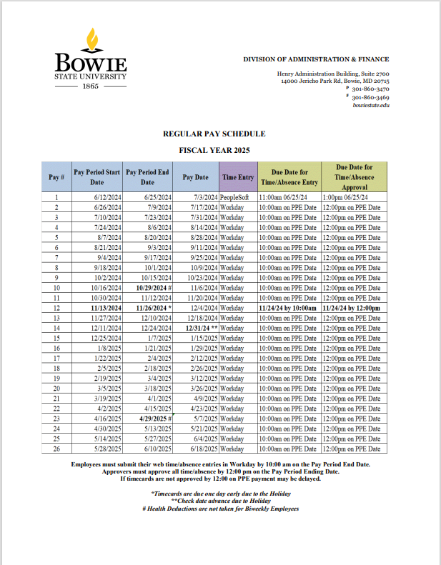
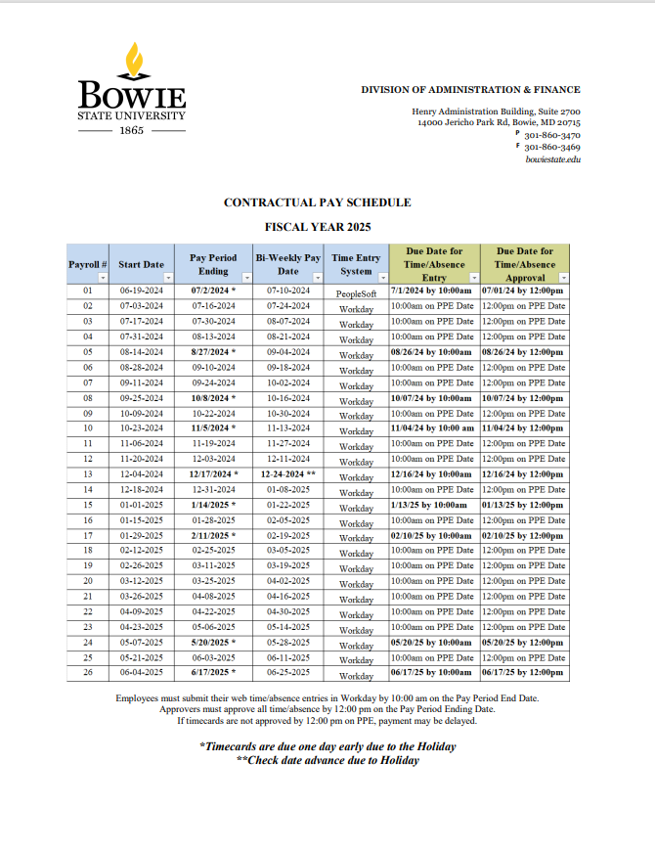
Pay Schedules
Notes:
Fdfj
The Comptroller's Office and the Central Payroll Bureau are excited to offer the new Payroll Online Service Center to provide services that have been requested by state employees.

Slide 53
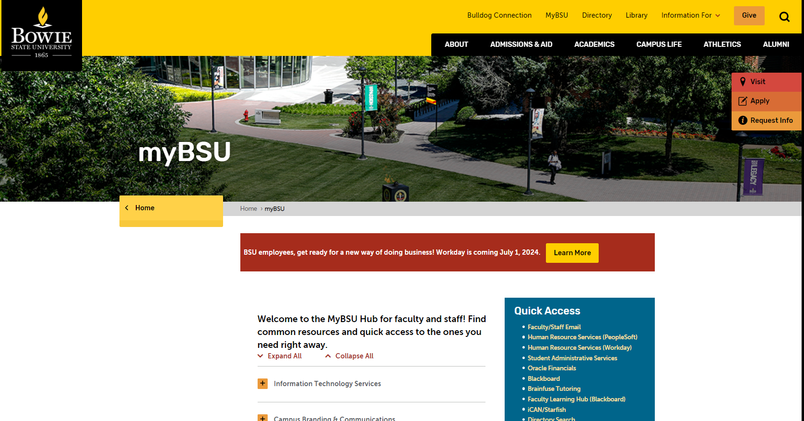
Accessing Workday
To access your Workday Homepage
www.bowiestate.edu
MyBSU
Human Resources Services (Workday)
Notes:
Fdfj
The Comptroller's Office and the Central Payroll Bureau are excited to offer the new Payroll Online Service Center to provide services that have been requested by state employees.

Slide 54

Accessing Workday
Notes:
Fdfj
The Comptroller's Office and the Central Payroll Bureau are excited to offer the new Payroll Online Service Center to provide services that have been requested by state employees.

Slide 55
Workday Time Entry
Timesheets for all employees (Regular and Contractual) are due for submission in Workday
no later than 11:00 a.m. on the pay period end date.
Approvers
Timesheet approvers must approve their employees' timesheets by 1:00 p.m. on the pay period end date.
If employees' timecards are not complete and approved on time, their pay may be delayed to the next pay period.
For questions, do not hesitate to get in touch with the following:
• Payroll at payroll@bowiestate.edu
• Ms. Sandy Lockett at llockett@bowiestate.edu
• Mrs. Jonita Leonard at jkleonard@bowiestate.edu
Notes:
Fdfj
The Comptroller's Office and the Central Payroll Bureau are excited to offer the new Payroll Online Service Center to provide services that have been requested by state employees.

Slide 56
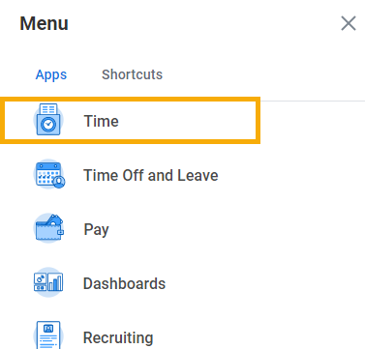
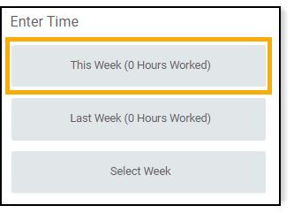
Enter Time (Exempt)
time for another week, select either the Last Week or Select Week.
Enter Time: Exempt Employee
1. Select the Time Application from the Menu.
2. The Time dashboard displays.
Note: Exempt Employees should not use the Check In and Check out feature.
3. Select This Week under Enter Time column.
Note: If entering time for another week, select either the Last Week or Select Week.
Enter, View, and Submit Time - 03: Non-Exempt Enter Time
Enter, View, and Submit Time - 02: Exempt Time Entry
4. Select a Date on the calendar to record time.
Notes:
Navigate to different weeks by selecting the arrows next to Today.
Select the down arrow next to the week range to display a calendar view.
Select the down arrow next to Week to enter time by Week, or Day.
Select Actions to choose additional tasks like Quick Add and Request Absence.
5. The Enter Time pop up displays.
6. Time Type: Defaults to Worked Time.
7. Enter the Number of Hours worked in the Hours field.
Note: Time can also be added as increments of 0.25 (Quarter Hours).
8. (Optional) Enter any Comments regarding this time entry in the Comments text box.
9. Select OK.
Notes:
After selecting OK, the hours worked display on the calendar and show as Not Submitted.
Entering time does not automatically submit the time.
After all time is entered for the time period, see Submit Time section in this job aid to submit time for the Timekeeper’s or the Manager’s review.
If you need to edit or delete time, click on the existing block.

Slide 57

Enter Time (Exempt)
Enter, View, and Submit Time - 03: Non-Exempt Enter Time
Enter, View, and Submit Time - 02: Exempt Time Entry

Slide 58

Enter Time (Non-Exempt)
Enter, View, and Submit Time - 03: Non-Exempt Enter Time
Enter, View, and Submit Time - 02: Exempt Time Entry

Slide 59

Managing Payroll Information
The Comptroller of Maryland and the Central Payroll Bureau offer a Payroll Online Service Center (POSC) for State employees to manage their payroll information.
1st time users are required to sign up online to setup a POSC account (This requires some personalized data found on your 1st pay stub).
You may access to payment information such as:
Pay stub information
W2 data
Change/update direct deposit banking information
Online submission of address updates
W4 Withholding or change of address
1st paycheck will be a paper check mailed to you at your home address.
You can use the information on the check to generate a Logon ID and Password , that will be used each subsequent time you access the POSC.
2nd paycheck should be direct deposit (you must enroll). *Complete the direct deposit form (type on the pdf, print, and then sign with a ‘wet’ signature.)
Direct link: Human Resources Services
Contact: Sandra Lockett Payroll Manager (301) 860-3483
Notes:
Fdfj
The Comptroller's Office and the Central Payroll Bureau are excited to offer the new Payroll Online Service Center to provide services that have been requested by state employees.

Slide 60
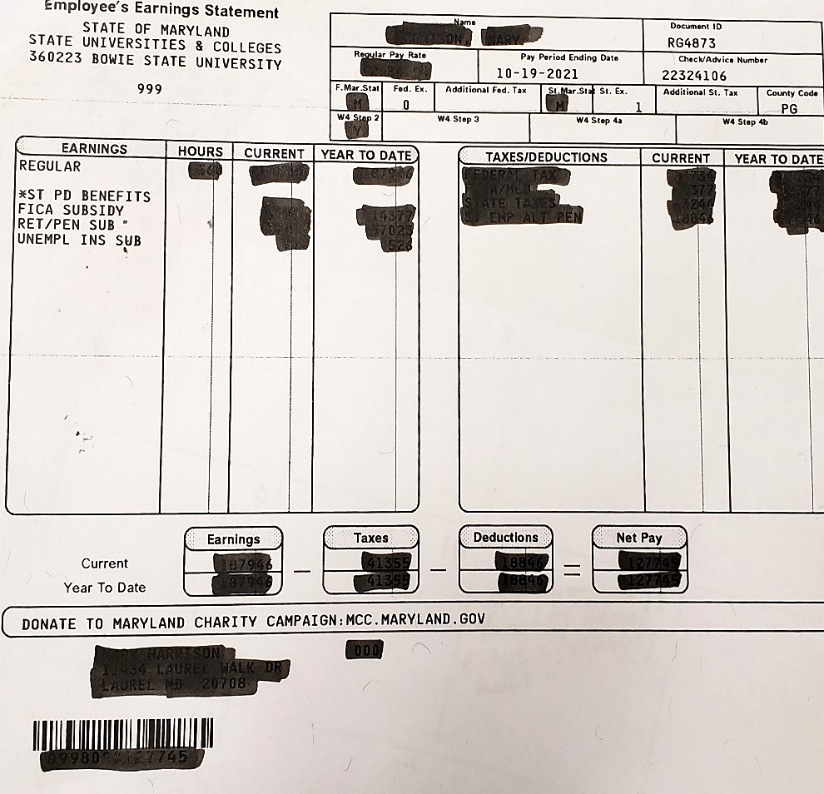
How to Sign Up with the Payroll Online Service Center (POSC)
Go to the POSC website and choose Sign-Up
To complete the SignUp process and establish a Logon ID & Password, you will be required to supply the following information:
Social Security Number
Date of Birth
BSU Agency Number (360223)
Check /Advice Number (found on the top right corner of your paper check paystub)
It takes less than 5 minutes to setup.
If you have any trouble, please send an email to
• Payroll at payroll@bowiestate.edu
• Ms. Sandy Lockett at llockett@bowiestate.edu
• Mrs. Jonita Leonard at jkleonard@bowiestate.edu
Notes:
Fdfj
The Comptroller's Office and the Central Payroll Bureau are excited to offer the new Payroll Online Service Center to provide services that have been requested by state employees.

Slide 61
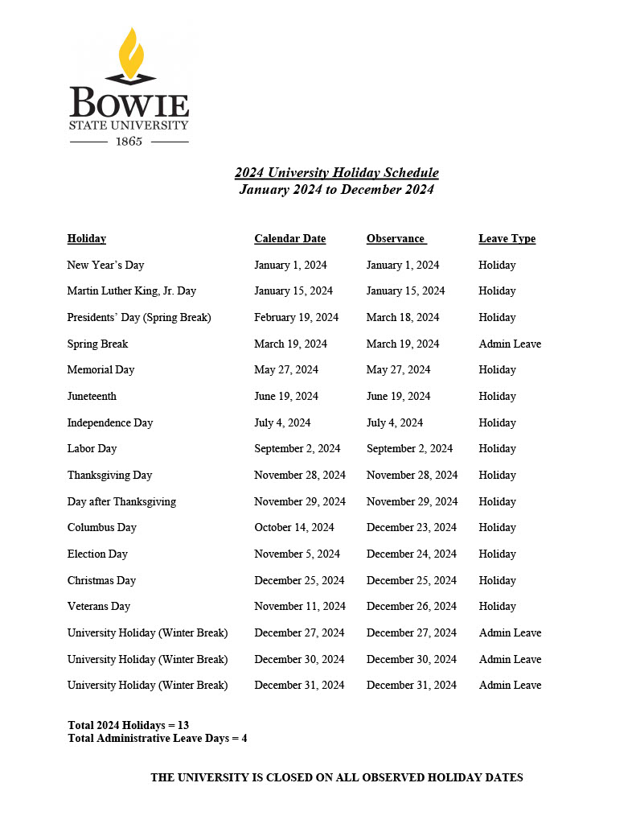
BSU Holiday Schedule
13 holidays in 2024
4 Administrative leave days
The University is closed on all observed holiday dates

Slide 62
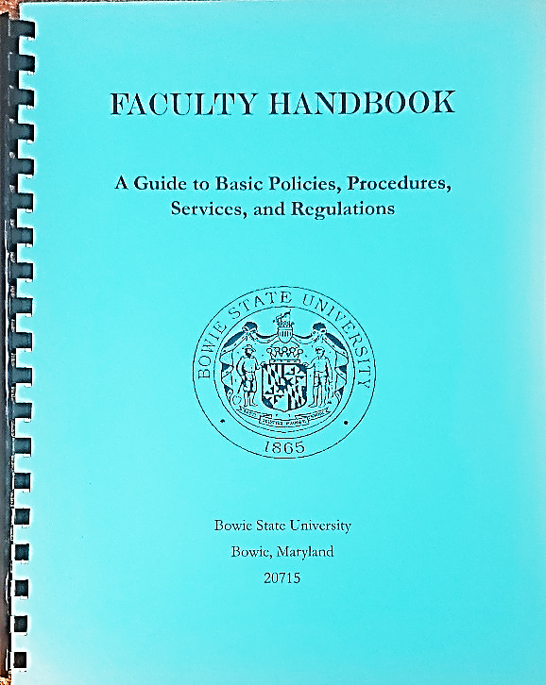

Employee/Faculty Handbook
Guide to Basic Policies, Procedures, Services and Regulations
Available electronically

Slide 63

Message from the Parking Office
Parking permits must be displayed to park on campus.
2-ways to pay
Direct payment
Payroll deductions (bi-weekly)
Pay at Student Accounts
Permits obtained
McKeldin Gym (preferred)
Communications Office (Robinson Hall)
Lot Designation: Permit designates the lot(s) you may park
There is a 20% discount for qualifying green cars.
Notes:
Parking permits must be obtained and displayed at all times while parking on campus.
After payment a valid receipt from Student accounts is taken to McKeldin Gym or DPS Communications Office in Robinson Hall
Please allow up to 30 business days to see the deduction
$20 for a second permit or list both vehicle tag numbers on application form
20% discount on permit cost on energy efficient cars. Must show proof of Energy Efficient Qualifying vehicle visit www.greenercars.org after scoring 40 or higher as rated by ACEEE.
Valid Parking Permit
A permit is valid only when it corresponds to the license plate number registered at the BSU Parking Office;
displayed properly
Visible
Not suspended, altered, or revoked.
A parking permit is transferable only to vehicles listed on the registration card. If the permit is affixed to an unregistered vehicle, the owner of the vehicle will be subject to a $100 fine, and the owner of the permit is subject to revocation of parking privileges (with no refund). All permits must hang from the rearview mirror with the expiration date visible from the front of the vehicle. Motorcycles must be registered.
Special Medical Arrangements
To utilize a handicapped space on campus, a driver must purchase a BSU parking permit and meet the State requirements to obtain a disability placard or handicap license plate.

Slide 64
Parking Authorization Form
Full time employees can receive payroll deductions
Can sign up in August (memo will go out)
After enrollment, please allow up to 30 days to see deductions
$5.25 Bi-weekly ($105 annually)
Contact: Lavel Jones,
Program Management Specialist,
(301) 860-4050
Notes:
The Pre-Tax Deduction Authorization Form must be completed before the beginning of the fall semester by all qualified full-time faculty and staff to obtain a yearlong parking permit (September 1 – August 31).
Bi-weekly deductions will be made for a total of 20 pay periods beginning September and ending in May. The deduction will appear on your paystub as 20-PAY PARKING.
New employees hired after September will begin their payroll deduction on the next payroll cycle after completion of the Authorization Form. New employees hired from June to August of each year will be required to purchase a short-term permit through the Student Accounts Office.
Once payroll deductions have been initiated by the State Central Payroll Bureau, there will be no refunds. The payroll deduction will automatically renew in July of each year and parking fees can be amended in accordance with future fee changes. An employee may also select to cancel this payroll deduction at this time by checking the “Cancel Box” on the Deduction Authorization Form.
Deductions end upon separation of service to the University It is the employee’s responsibility to return the parking permit to the Parking Office before the Clearance Certificate Form will be completed by Campus Safety.

Slide 65
Parking Authorization Form
Discount on Energy Efficient Cars
Drivers with a vehicle scoring 40 or higher as rated by American Council for Energy-Efficient Economy receive a 20% discount on the rates above. See greenercars.org to find out if you qualify.
Type | Fee
Resident Student | $100.00
Commuter Student | $93.00
Faculty/Staff | $105.00
Faculty/Staff reserved | $145.00
Faculity/Staff semester only | $65.00
Student Semester only | $60.00
Monthly | $50.00
Fall 2022/Spring 2023
NOTE: All fees are subject to change without prior notice.

Slide 66

Parking Rules and Regulations
Dept. of Public Safety Parking Rules and Regulations Booklet
Contact: Lavel Jones, Program Management Specialist,
(301) 860-4050

Slide 67

Percipio e-Learning Platform
Percipio is a huge library of video training courses taught by respected professionals . Thousands of courses, tutorials and learning assets such as eBooks, test prep, and job aids etc.
Free unlimited access
Available 24/7
May be used to support blended learning
Thousands of videos and tutorials (eg. Software, creative arts, business skills, and more)
Notes:
Enhance your IT skills or learn something new, Bowie State University offers free unlimited online access to Lynda.com 24/7
Thousands of videos and tutorials all in one place
Blended learning

Slide 68


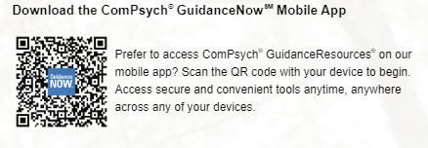
Employee Assistance Program
Your GuidanceResources® Employee Assistance Program provides counseling and other services to help you. This program is confidential and free to you and your family members who live with you 24-hour service
Legal Guidance
Confidential Emotional Support
Work-Life Solutions
Financial Resources
Online Support
Life coaching
Wellness webinars
Available per house, not per family member
Access online at guidanceresources.com
Web ID: USMEAP
Download App: GuidanceNow

Slide 69


Credit Union Affiliation
State Employee Credit Union (SECU) is available for you as a State of Maryland employee.
SECU offers employees free checking, share saving, direct deposit, convenient payroll deduction, ATM services, new and used auto loans, and other financial services.
Scan the CR Code to find out more about SECU

Slide 70
Henry Wise Wellness Center
Services offered to Staff and Faculty such as:
Campus-wide wellness events
First aid
Blood pressure screening
Weight measurement
Aspirins
Call emergency or ambulance (if needed) Care and treatment at the Wellness Center are provided solely for work-related injuries will be in the form of Emergency response only
For more information, contact the Wellness Center at 2-4170
Notes:
Procedure
Care and treatment at the Wellness Center are provided solely for work-related injuries will be in the form of Emergency response only. The employee will be referred to the Department of Human Resources and to the health center below for treatment.
Concentra Medical Center
4451 G Parliament Place
Lanham, MD 20706
Phone: 301-459-9113
Fax: 301-459-1214
Employees not wishing to go to Concentra may choose to seek treatment for their work-related injury or illness with their personal physician. In the event of an emergency, the employee or his supervisor should call Campus Security at 301-860-4040 and/or 911 for ambulance transport to the nearest hospital.
List of medical centers offering emergency medical care include:
Doctor’s Hospital
8118 Good Luck Road
Lanham, MD 20706
301-552-8118
University of Maryland Capitol Regional Medical Center
901 Harry S Truman Drive
Largo, MD 20774
240-677-1000
Staff and Faculty with Acute/Chronic Medical Illness and/or Injuries
All Bowie State University employees (staff and faculty) suffering from chronic medical conditions should follow up with their primary care providers. Those employees who wish to receive care for acute illnesses/injuries should make an appointment with their primary care providers. The Wellness Center will only provide first aid/triage for staff and faculty. In the event of emergency, Campus Safety should be contacted at (301)860-4040 for activation of emergency transport to the nearest hospital.

Slide 71

Questions

